Slide 1
BFX AT-100 FHD channel (live) noise FA report
Prepare by: PE – JUSTIN
Date: 2025/08/19

Slide 2
Problem Description
Issue Description (5W2H)
When | 2025-May-24
Who | SH Son
Where | ALT customer side, Location : SK networks warehouse, Anseong, Korea.
What | ALT customer return 1pc BFX-AT 100 have video FHD (1920 x 1080, codecs: H264 AVC/AAC) channel live suffers from image noise
Why | TBD
How | NG product have video FHD channel (live) image noise: S/N range: 2149688001202503069476
How much | 1pcs / 60.000 pcs ~ 0.00166% (Qty inspection lot 60k delivered on 2025.4)

Slide 3


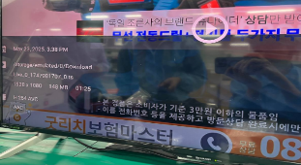
Confirm Fail Symptom
Double check fail symptom:
Use product have customer account to play “Live_0_1747981707_0.ts” video in app “MX player” ➔ FHD (1920 x 1080, codecs: H264 AVC/AAC) channel live suffers from image noise
FHD channel (live) image noise
FHD channel (live) image OK
*FHD (1920x1080) channel live video with codecs: H.264 AVC/ACC shows image noise issue (pink smearing) during playback.
Summary:
NG product play video FHD channel (live) (1920 x 1080, H264 AVC/AAC) suffers from image noise

Slide 4
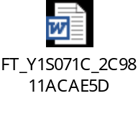
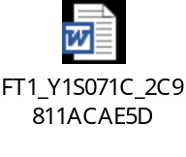
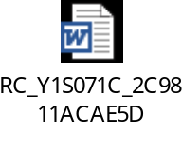
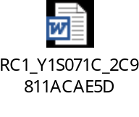
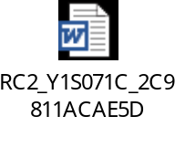
Production History Data Checking
T Level data (SMT)
SN | Test Station
Y1S071C | SMT LOADING | INSP-OUTSIDE | PCB_STOCKIN
 | 2025-03-14 16:25:11 | 2025-03-17 20:44:18 | 2025-03-17 22:02:13
Dot Level data (FATP )
S/N range | Test Station
2149688001202503069476 | UK | FT | FT1 | RC | RC1 | RC2
 | 3/22/2025 11:26 | 3/22/2025 11:34 | 3/22/2025 11:42 | 3/22/2025 12:02 | 3/22/2025 12:20 | 3/22/2025 13:17
Test logs | UK test haven’t logs test
Summary:
- This unit has PASSED normally SMT and FATP.
- Shipping date: 2025/03/26 2:45AM

Slide 5













Visual Inspection And X-ray Checking
VI checking:
SIZE | IMAGE | RESULT
TOP |  | NORMAL
BOT |  | WARRANTY SEAL BROKE
PART |  | NORMAL
X-ray checking:
S/N | U503 | U504 | U505 | U506 | U602 | U1 | U1101 | FIL1401 | FIL1402
Y1S071C
Summary:
- VI found product warranty seal broken
- X-ray: No found abnormal

Slide 6
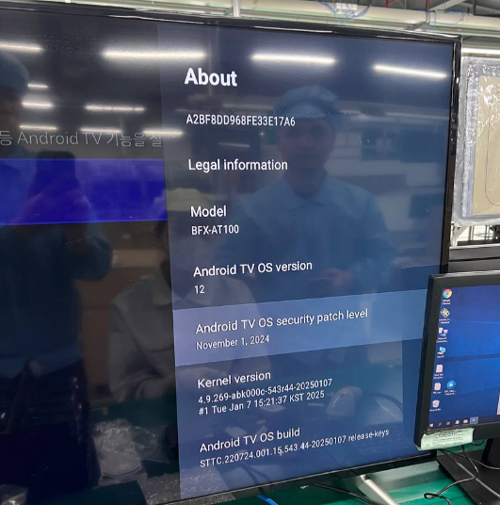
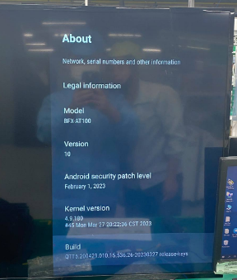
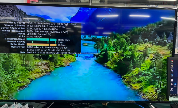
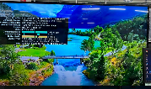
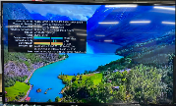
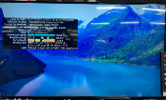
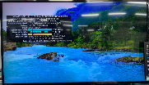
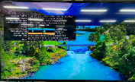
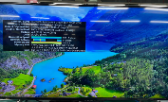
Re-test Analysis
Re-test at OBA station:
- Can’t re-test at OBA because the product had login customer account and update version (Software version 12)
- Product use the factory software can test at OBA station (Software version 10)
Check function play YOUTUBE video at OBA station:
240p (426x240 30fps/codecs VP9)
360p (640x360 30fps/codecs VP9
480p (854x480 30fps/codecs VP9
720p (1280x720 30 fps/codecs VP9)
Normal
Video QHD (2560x1440 30 fps/codecs VP9)
Video FHD (1920x1080 30fps/codecs VP9)
Video UHD (3840x2160 30fps/codecs VP9)
Summary:
- Product can’t re-test at OBA station
- Check video YOUTUBE: no found abnormal

Slide 7
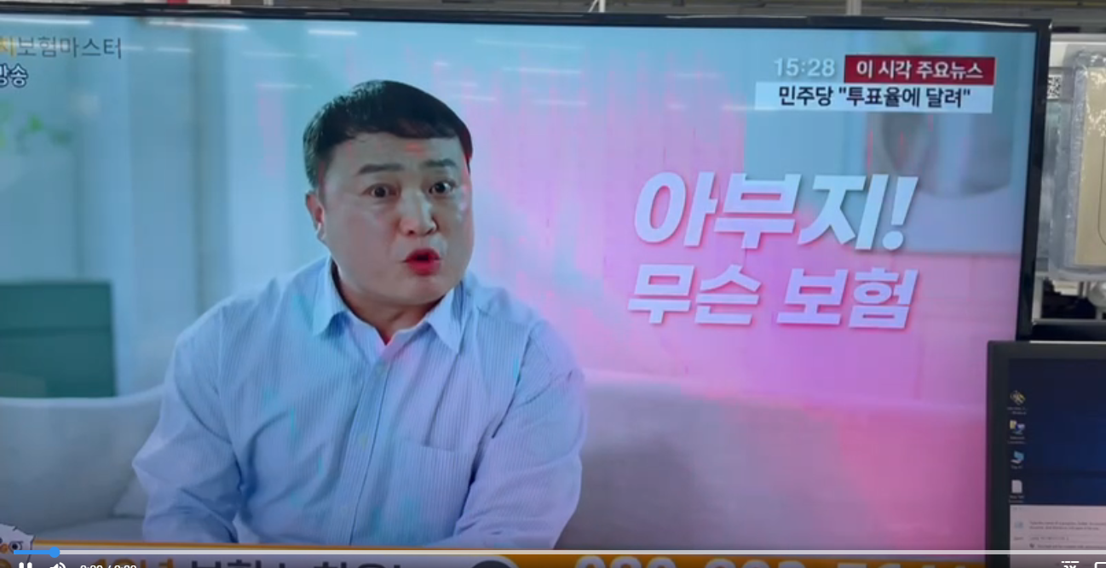

Android Version Verification
Check fail symptom at other android version:
Product | Android Ver | FA progress and conclusion by step | Image Sample
NG | 12 | *Check version of “MX player” app found NG board use old version - Update version of “MX Player” old version 1.94.4 → New version 1.97.8 → Then play video FHD channel live Result: NG product still noise image
 | 10 | *Play video FHD channel live Result: NG product still noise image
OK | 12 | Open “MX player” app and play video FHD channel live Result: OK product hasn’t noise image
 | 10
FHD channel live still noise
FHD channel live normal image
Summary:
- NG board still noise

Slide 8
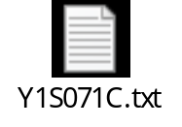

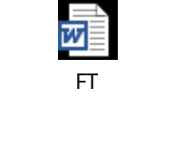

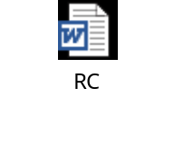

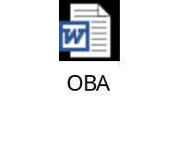
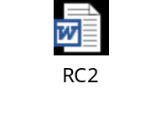
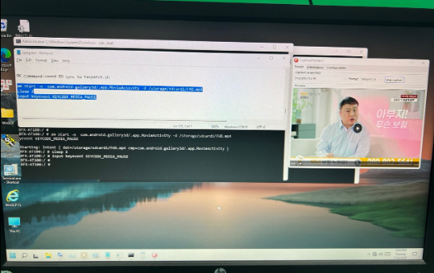
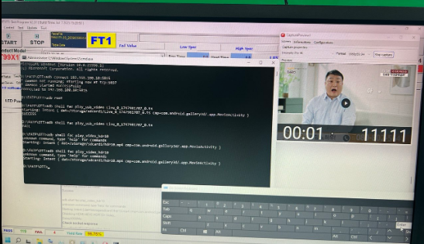
Factory Image Verification
Backup factory image
- Check console log of NG board.➔ ➔ No found abnormal
- Re-test at FATP:
Station | UK | FT | FT1 | RC | RC1 | OBA | RC2
Log
Result | Pass | Pass | Pass | Pass | Pass | Pass | Pass
Verify noise at factory image
- Play FHD channel live on NG board → Still noise image
NG
OK
Summary:
- Re-test at FATP → Pass normally
- At factory image, NG board still noise

Slide 9
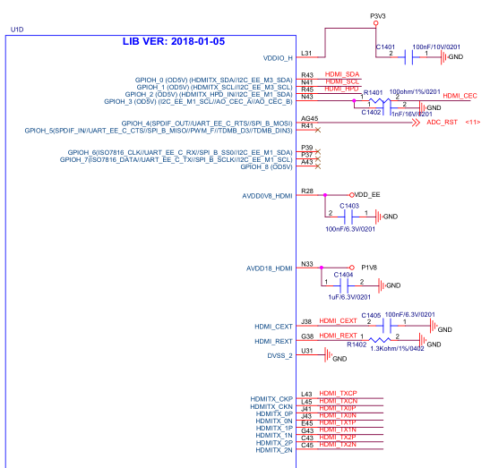
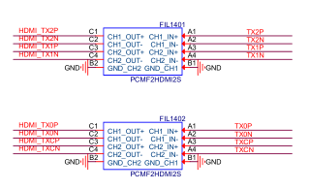
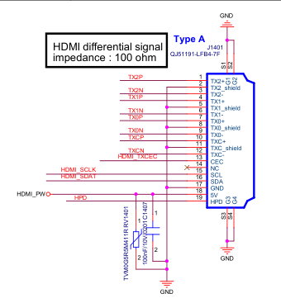
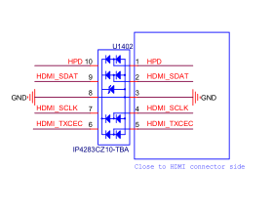
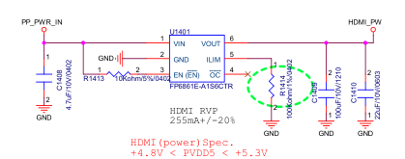
Measurement Analysis
Measurement impedance and voltage of HDMI signal
Measure impedance NG board
Signal pin | NG |  | OK sample
 | Impedance | Voltage | Impedance | Voltage
TX2P | 3.150M | 0.011 | 3.148M | 0.012
GND | 0 | 0 | 0 | 0
TX2N | 3.153M | 0.026 | 3.150M | 0.024
TX1P | 3.138M | 0.001 | 3.146 | 0.002
GND | 0 | 0 | 0 | 0
TX1N | 3.151M | 0.004 | 3.154M | 0.003
TX0P | 3.155M | 0 | 3.155M | 0
GND | 0 | 0 | 0 | 0
TX0N | 3.158M | 0.003 | 3.158M | 0.003
TXCP | 3.162M | 0.003 | 3.156M | 0.002
GND | 0 | 0 | 0 | 0
TXCN | 3.164M | 0.192 | 3.149M | 0.191
HDMI_TXCEC | 2.476M | 3.275 | 2.279M | 3.269
HDMI_SCLK | 2.447M | 5.109 | 2.459M | 5.113
HDMI_SDAT | 2.182M | 5.109 | 2.029M | 5.113
GND | 0 | 0 | 0 | 0
HDMI_PW | 1.749M | 5.109 | 1.874M | 5.113
HPD | 109.7K | 0.1 | 110.2K | 0.1
Summary:
- Impedance and voltage normal

Slide 10
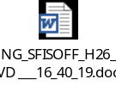

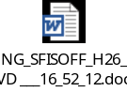

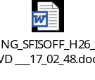
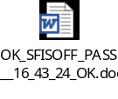
Noise Coverage Experiment
CMD verify to cover noise image
Step1: Download FHD video channel live and trimmed to 5 seconds, as the image noise issue is most clearly observed at the 1st and 2nd seconds.
Step2: A non-noise image was used as a reference sample to create the test command and perform verification.
Step3: Add command in the program at FT1 station to test and verify as below:
Product | 1st | 2nd | 3rd | 4th | 5th | Result
NG |  |  |  |  |  | Still Fail
OK |  |  |  |  |  | Pass
Step4: Then test and verify → Test program experiment can detect and cover noise image FHD video channel live
Summary:
- Test program experiment can detect and cover noise image FHD video channel live

Slide 11
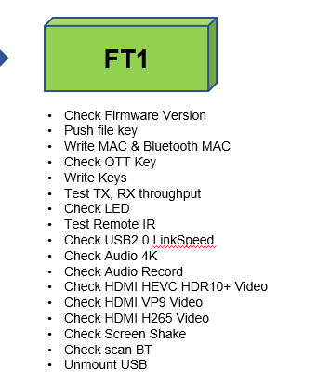
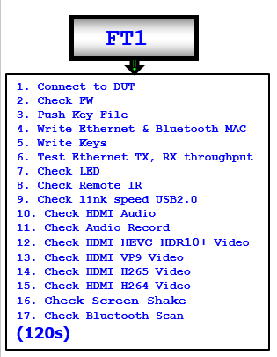
Control Run Contents
Software
Process
ECN
Material
Other
V
1. Background Information
- T99X171.00 CTR program experiment: add new item check noise image with name “Check HDMI H264 video” into test program at FT1 station
- Require control run 100pcs to verify noise image issue at factory image
2. Item control run
BFX-AT100: T99X171.00 needs to do CTR 100pcs to verify add new item “Check HDMI H264 video” at FT1 station:
3. Purpose control run
- Verify test program add item check HDMI H264 video to cover noise image issue
Old test plan
New test plan
No item check H264 video
Have item “check HDMI H264 video”

Slide 12
Control Run Result
1. SMT & PTH Yield Rate
Station | Section Name | Pass Q'ty | Defect Q'ty | Total Q'ty | Yield Rate | Target
SMT | TURN PCB | 100 | 0 | 100 | 100.00% | 100%
 | ISNP | 100 | 0 | 100 | 100.00% | 100%
 | X-RAY | 100 | 0 | 100 | 100.00% | 100%
PTH | PCB STOCKIN | 100 | 0 | 100 | 100.00% | 100%
2. FATP Yield Rate
ALT |  |  | Model Name: T99X171.00
 |  |  | Quantity |  | 100pcs
 |  |  | Product image |  | K000b-523r06_SD_fac-20220118
 |  |  | Customer image |  | 15.536.26
 |  |  | MO |  | 2643012107
 |  |  | Date |  | 14/08/2025
1.Product Yield & FA Report
Customer | Product Model | Test Station |  | Yield Rate | Statistical |  |  | Yield Rate
 |  |  |  |  | Total | Pass | Fail
ALT production | BFX-AT100 T99X171.00 | UK |  | 100.00% | 100 | 100 | 0 | 100%
 |  | FT |  | 100.00% | 100 | 100 | 0 | 100%
 |  | FT1 |  | 100.00% | 100 | 100 | 0 | 100%
 |  | FT3 |  | 100.00% | 100 | 100 | 0 | 100%
 |  | RC |  | 100.00% | 100 | 100 | 0 | 100%
 |  | RC1 |  | 100.00% | 100 | 100 | 0 | 100%
 |  | RC2 |  | 100.00% | 100 | 100 | 0 | 100%
 |  | Final Yield Rate(%) |  | 100%
Summary:
- Verification of the test program at FT1 station with NG DUT➔ All test systems successfully detected the noise image failure on the NG DUT
- SMT, PTH & FATP yield rate 100%➔ Recommended use this item “Check HDMI H264 video” for MP

Slide 13
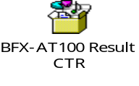
Summary
No.# | Items | Result
1 | Confirm Fail Symptom | - FHD (1920 x 1080, codecs: H264 AVC/AAC) channel live suffers from image noise
2 | Production history | - No abnormal
3 | Visual Inspection And X-ray Checking | - VI found product warranty seal broken - X-ray no found abnormal
4 | OBA Function Analysis | - Product can’t re-test at OBA station - Check video YOUTOBE: no found abnormal
5 | Android Version Verification | - NG board still noise when change other android version
6 | Factory Image Verification | - Product pass normally at FATP - Noise image can detect at factory image
7 | Measurement Analysis | - Impedance and voltage no abnormal
8 | Noise Coverage Experiment | - Test program experiment can detect and cover noise image FHD video channel live
9 | Control Run Cover Noise Image | - Done. The factory have been able to detect the noise image issue.
*Result:
- Control run add new item to check noise image at FT1 station done.
- Fii used the NG unit to verify the FT1 station in order to cover the noise image issue, and the test program was fully able to detect the noise image failure.
➔ The factory have been able to detect the noise image issue.

